Slide 1
SPUR: High-Fi Prototype
Simran, Hannah, Bhavya, Nils

Slide 2
Problem
Value Proposition
Our solution
Spur Recap
The time in your day when you're stuck scrolling on your phone, knowing that you should do something different but not knowing exactly what to do.
Thinking of an activity to do can be a drag, and planning one is such a headache. Both of which keep you scrolling and stuck in a rut.
Lowering the activation energy to find and plan an activity.
Browse suggested activities
Get information on details like location, time, and price
See which of your friends are interested in activities and invite them to do one
Activities without the activation energy.
― Maya Angelou

Slide 3
You can use this table of contents.
01 | HE Results
02 | Revisions
03 | Prototype Details
04 | Demo

Slide 4
HE Results
01

Slide 5
Heuristic Evaluation Summary
Most violations in H4 (Consistency and Standards), H3 (User Freedom and Control), and H1 (Visibility of System Status)
Need to provide users with clearer exit options throughout all three tasks
Providing user-specific context and personalization (location, interest, accessibility
Consistency in font, following gridlines in text and element placement
Fleshing out the Spur invitation to clarify the purpose of the app (will it help people actually do an activity or is it just to find activities?)

Slide 6
Severity 3
Severity 4
H1: When users click on the downward arrow to see more about an activity, the screen with more information about the activity has no back button.
H3: When users navigate through the suggested activities, there is no way for users to go back to an activity they have already viewed.
H3: When users accept an activity, there’s a button at the top right that says “leave”. It’s unsure of whether this means the person is leaving the activity or whether the activity is currently in session.
H3: When users create a spur, the top right button says “end”. Again, it’s a bit unclear as to what exactly this means.
H3: Can’t remove friend from friend’s tab

Slide 7
Takeaways
Improve navigation signifiers so users can better understand how to travel through the app
Revise how the Spur creation process works to improve clarity
  Changing the phrasing of buttons like “end”->"end session" and “leave”->"leave session"
  Giving the users an options to set a time and specific location and make the “what you need” list a clearer itinerary
Providing users more exit/undo options with choices made in the app

Slide 8
Revisions
02

Slide 9
Revisions
Making swiping more intuitive
Exit options at each screen
Consistency in font and placement
Revising Spur creation process to include:
  A location selection menu (with nearest locations based on users current location)
  A time selection option
  Additional notes section to personalize the invitation/add details for invitee

Slide 10
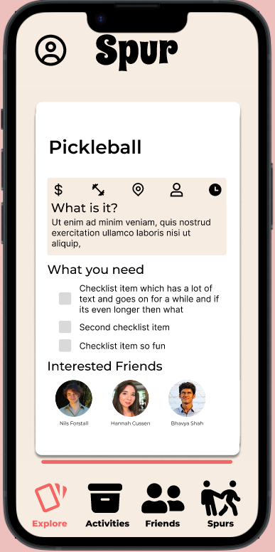
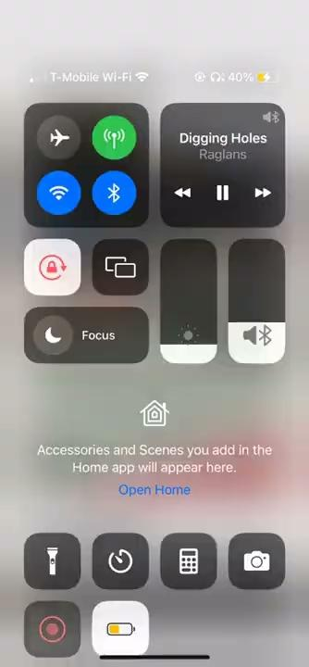
Change 1:
Instead of a button to click, you can now scroll down to view further information

Slide 11
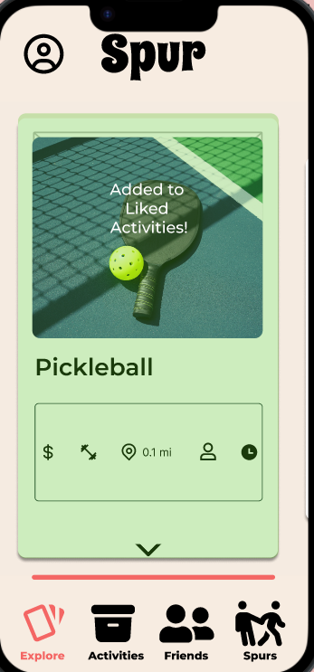
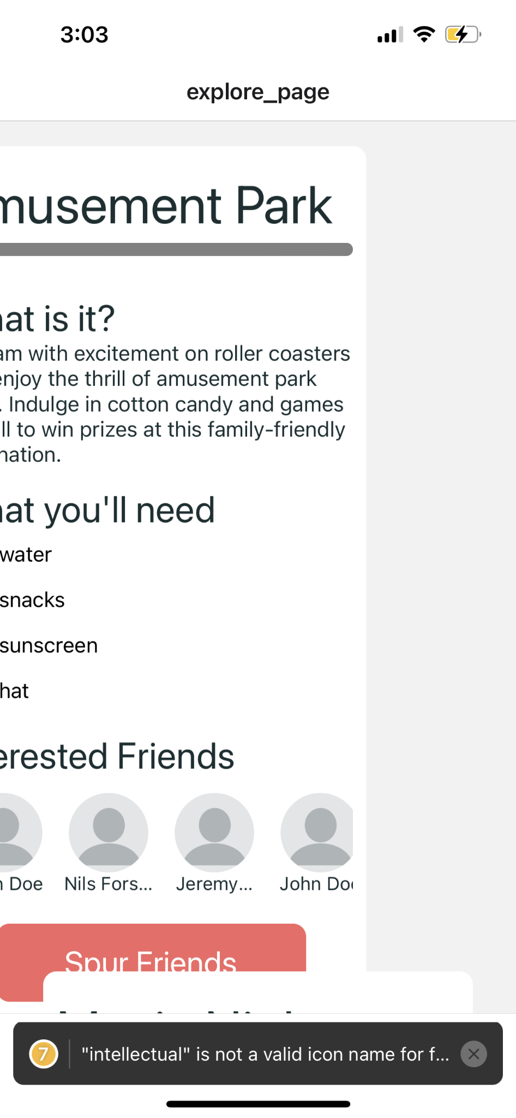
Change 2:
Swiping follows conventions of left = rejection and right = acceptance
(in our data management for now)

Slide 12
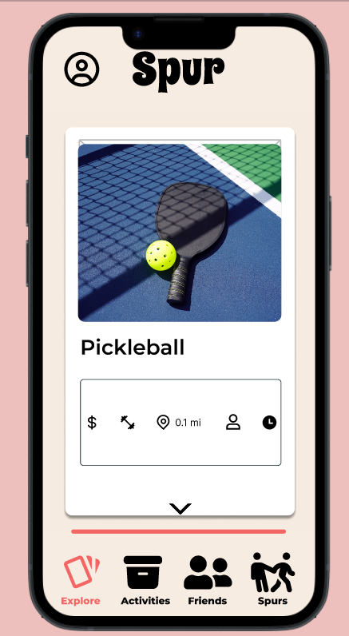
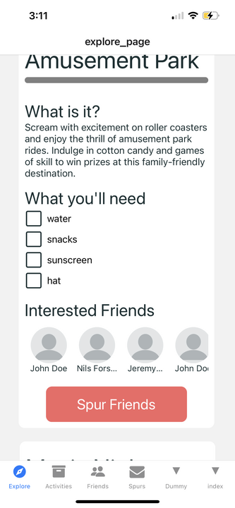
Change 3:
Added a “spur friends” button so that users can more easily invite a friend to the activity

Slide 13
Usability Goals
Intuitive and easy to master.
  The interface should explain itself with minimal tutorials.
Flexibility.
  People should be able to plan activities in the way they see fit, whether that starts with choosing people or an activity

Slide 14
Usability Goal Progress
Flexibility
  Providing more options for users to undo/redo and cancel actions
  Saving activity information for viewing at any time (in progress)
Intuitive and easy to use
  Scrolling to see more information instead of button press is simpler
  Providing more signifiers for gestures that will work
  Adding more contextual information to icons

Slide 15
Prototype Details
03

Slide 16
Prototype Overview
React Native App
Supabase data storage
Hard-Coded:
  Friends
    Specific friend profiles are created, some already added as friends in app
  Activities
    The activities are all pre-selected (filters are pre-set)
Wizard of Oz:
  Finding locations and times for activities
    The app theoretically would make a call to scan for the nearest locations, and available hours, instead it is provided through a database

Slide 17
Implemented Features
Task #1: Swiping and Task #2: seeing more information about an activity are implemented (our “Explore Page”)
Populated database with most of the information needed for the app to function
Features
  Swiping
  Scrollable activity card with further information
  Activity information is saved and accessible throughout the app (for implementing other pages)

Slide 18
In Progress
Infrastructure for the Friends, My Activities, and Spurs pages
Components for the Friends and My Activities pages
App navigation
Undo button for swiping
Combining tasks #1 and #2 in the explore page
Incorporating color scheme, fonts, and other theme components

Slide 19
Demo
04

Slide 20
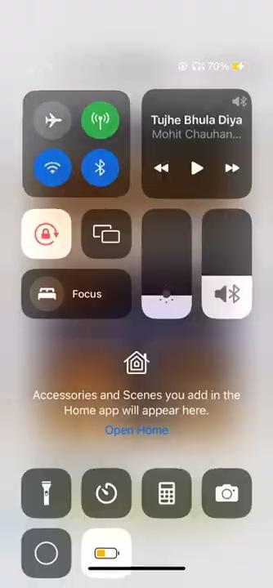

Slide 21
Thank you!

Slide 22
Credits.
Presentation Template: SlidesMania
Sample Images: Unsplash
Fonts used in this presentation: Happy Monkey and Londrina Solid.

